Slide 1
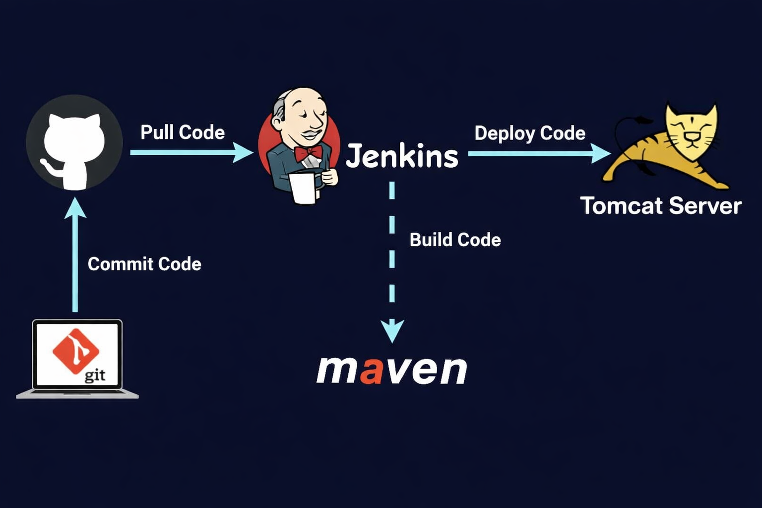
Architecture Overview

Slide 2
Project 1 End-to-End CI/CD Pipeline
Create GitHub repository and push Java web application
Configure Jenkins job with SCM trigger
Build application using Maven
Run unit tests and package WAR file
Deploy WAR file to Tomcat
Verify application via browser

Slide 3
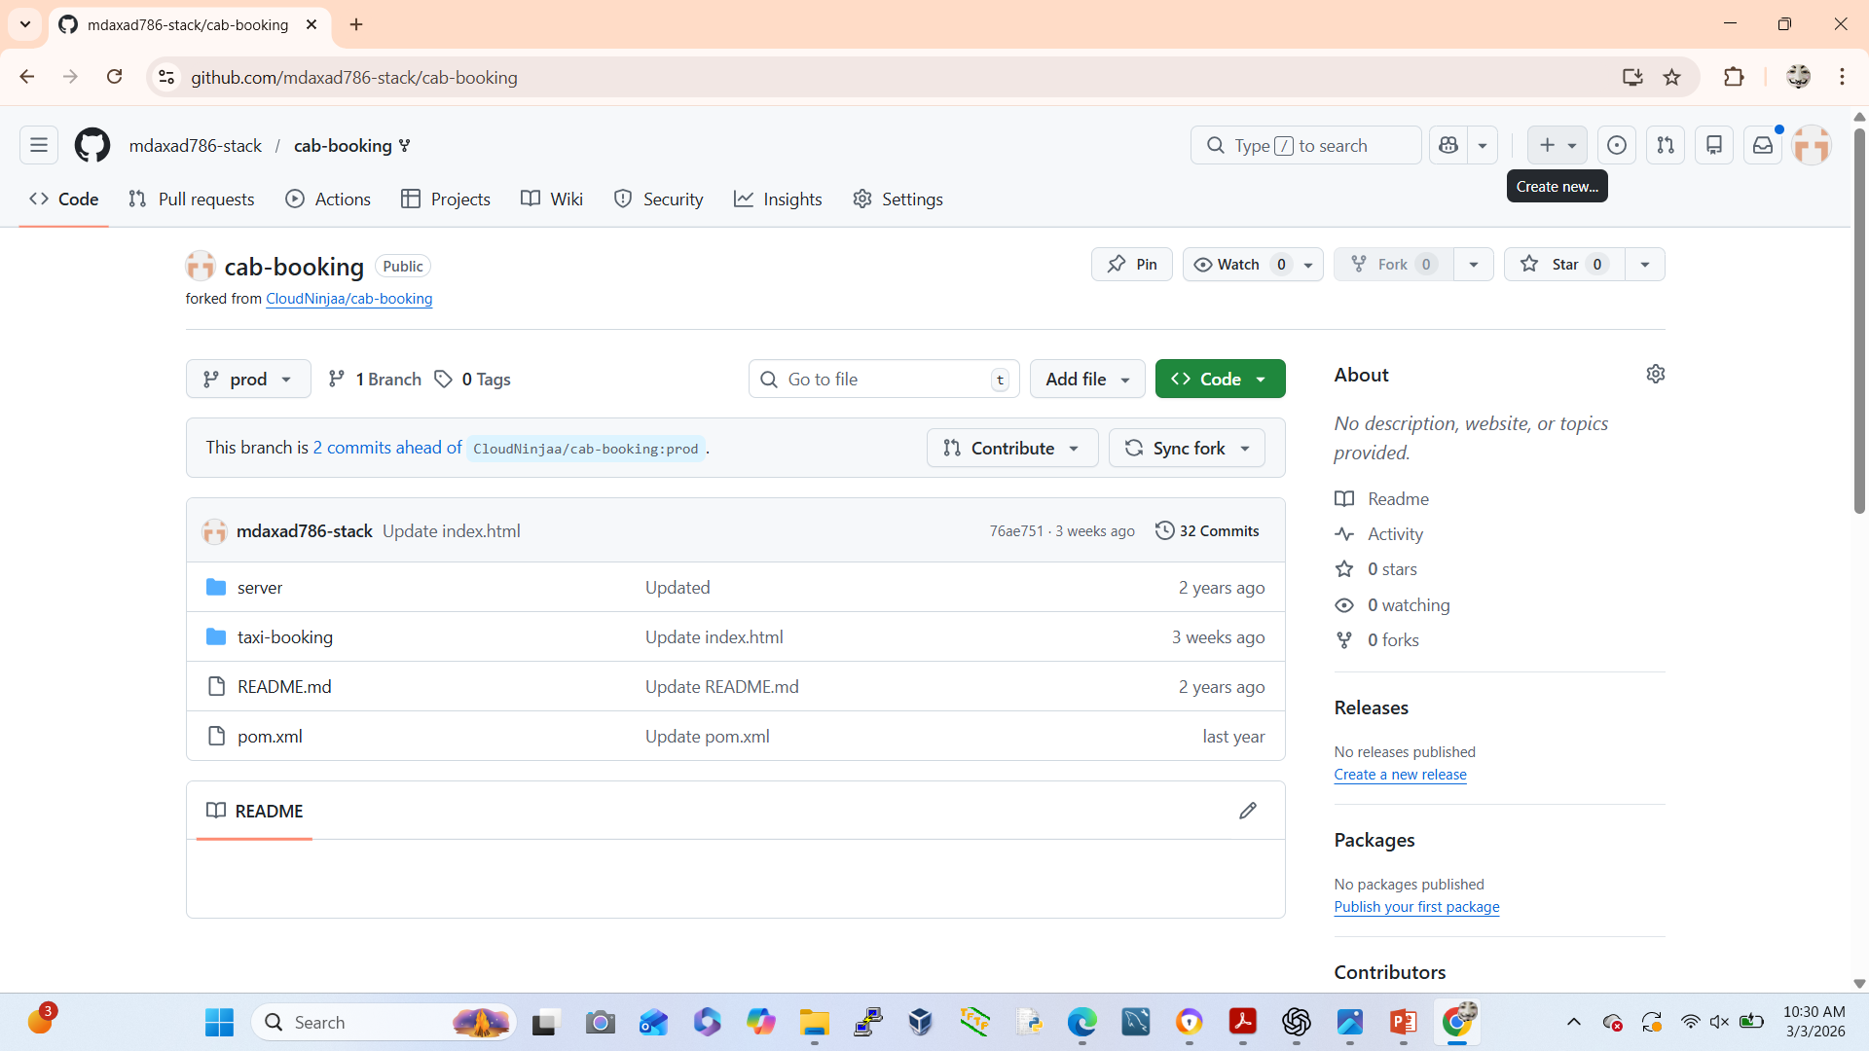
Create GitHub repository and push Java web application
Create Repository in GitHub
Go to GitHub
Click New Repository
Name it: cab-booking

Slide 4
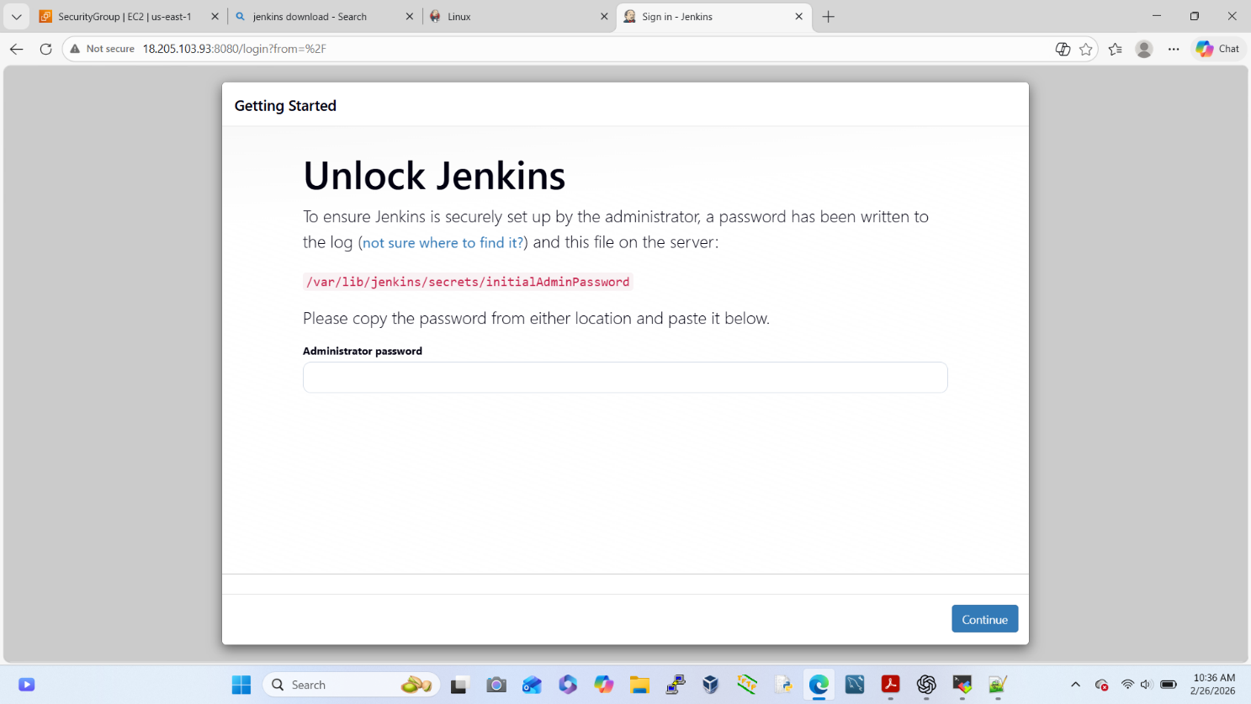
Configure Jenkins Job with SCM Trigger
Step: 1
Install Jenkins
Install Required Plugins in Jenkins
Git Plugin
Maven Integration Plugin
Deploy to Container Plugin

Slide 5
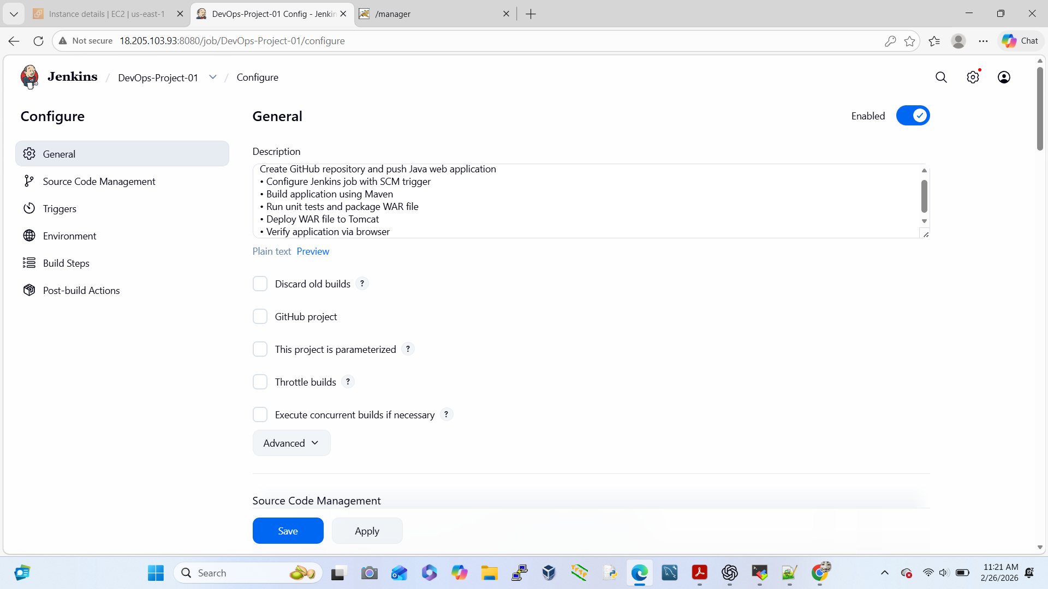
Step:2
Create New Jenkins Job
Click New Item
Select Freestyle Project
Name: cab-booking
Configure Source Code Management
Select Git
Add Repository URL
Configure Build Trigger (SCM Polling)
Poll SCM
Build Application Using Maven
Invoke top-level Maven targets
Goal:- clean install
Run Unit Tests & Package WAR
CompileTest phase
Package phase
Creates WAR file in:

Slide 6
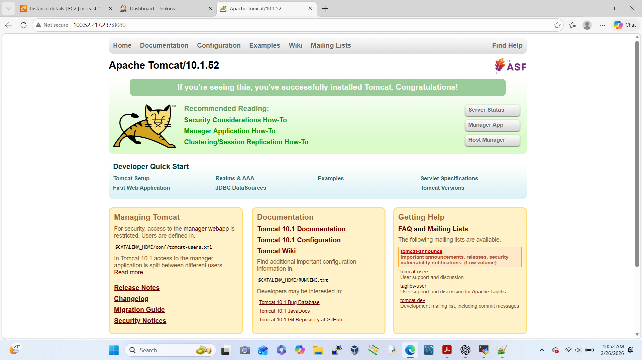
Deploy WAR File to Tomcat
Go to Chrome Browser & Search Tomcat
Now tomcat tar file copy
Open terminal cd /opt # tomcat tar file paste
Unzip:-# tar –xzvf (tomcat tar file-paste)
Rename:- # mv (tomcat unzip file)/ tomcat
Go to SG allow port no: 8080
Open new tab:- http://public ip:8080
Tomcat/bin/# ./startup.sh (Linux)
Installation completed Apache Tomcat.

Slide 7
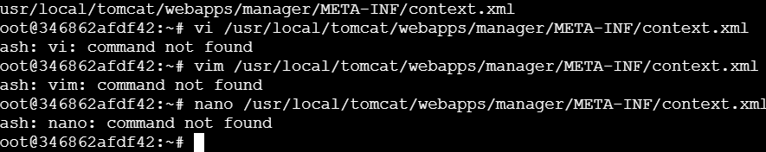
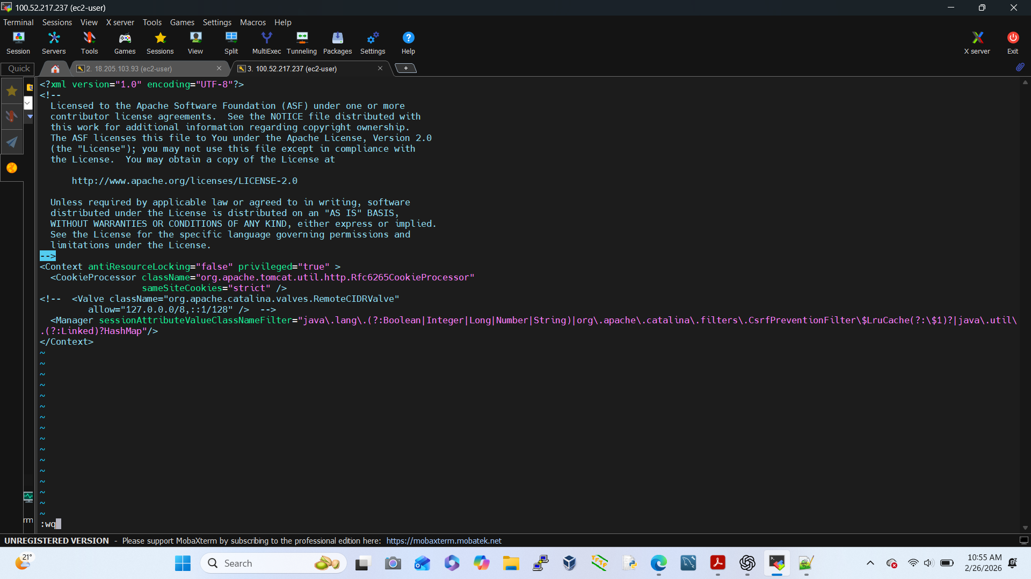
Configure Tomcat Users
Open terminal # find / -name context.xml
# vi /opt/tomcat/webapp/manager/META-INF/comtext.xml
# vi 2nd path paste here (both vi file under add
<!- - valve line (here add ) - - >
Save-→ Esc + shif + : wq -→Enter

Slide 8
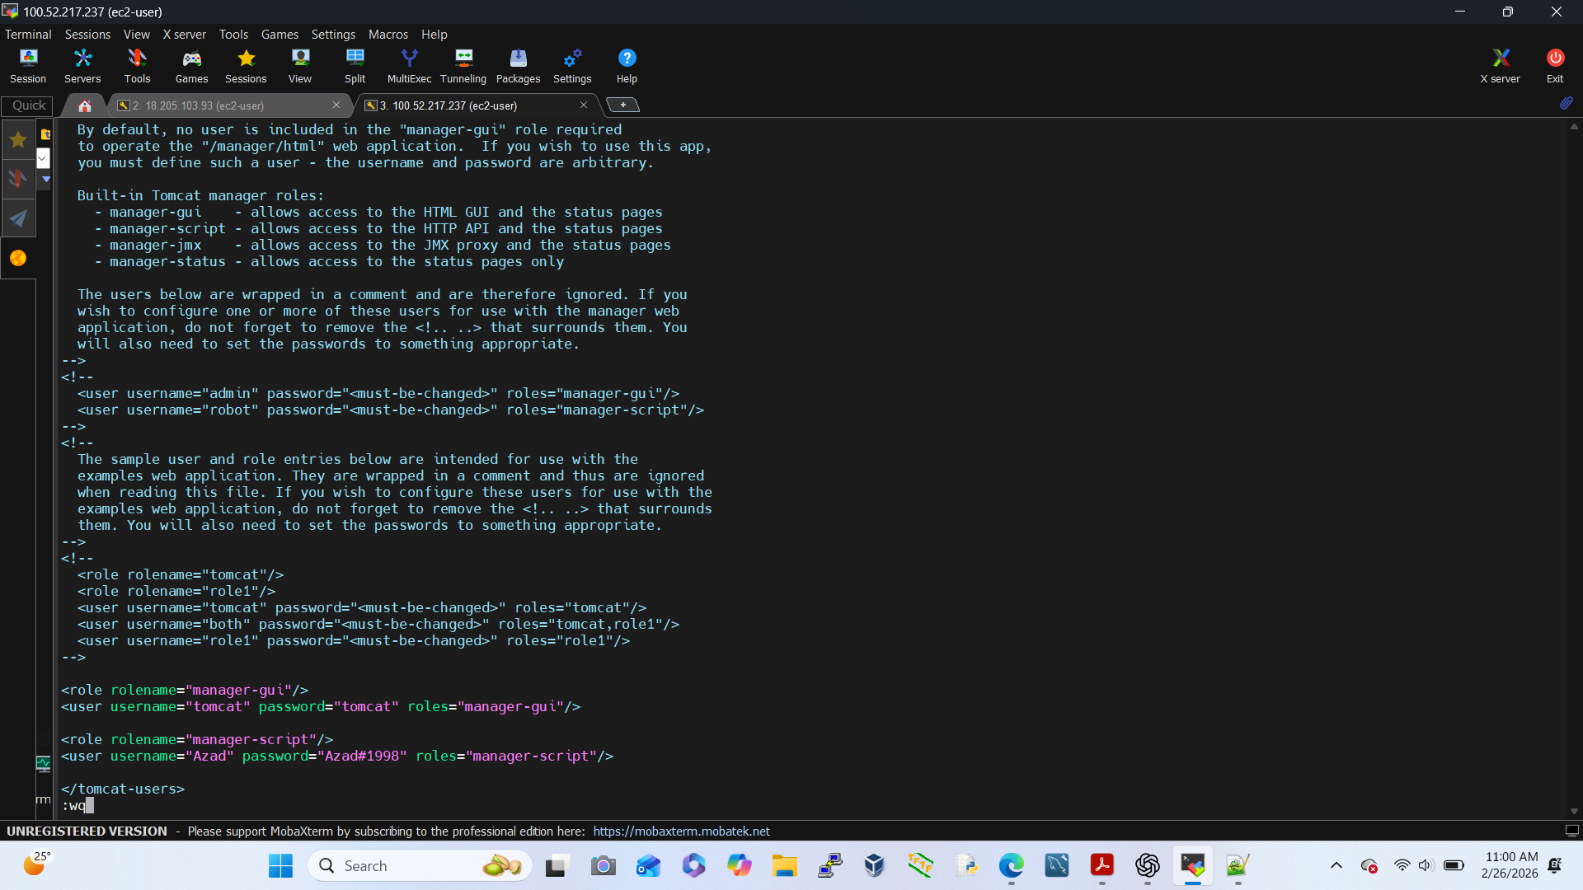
Open terminal:- #cd /opt/tomcat/conf
conf # vi tomcat-users.xml
<role rolename="manager-gui"/>
<user username=“tomcat" password=“tomcat" roles="manager-gui"/>
<role rolename="manager-script"/>
<user username=“Azad" password=“Azad#1998" roles="manager-script"/>

Slide 9
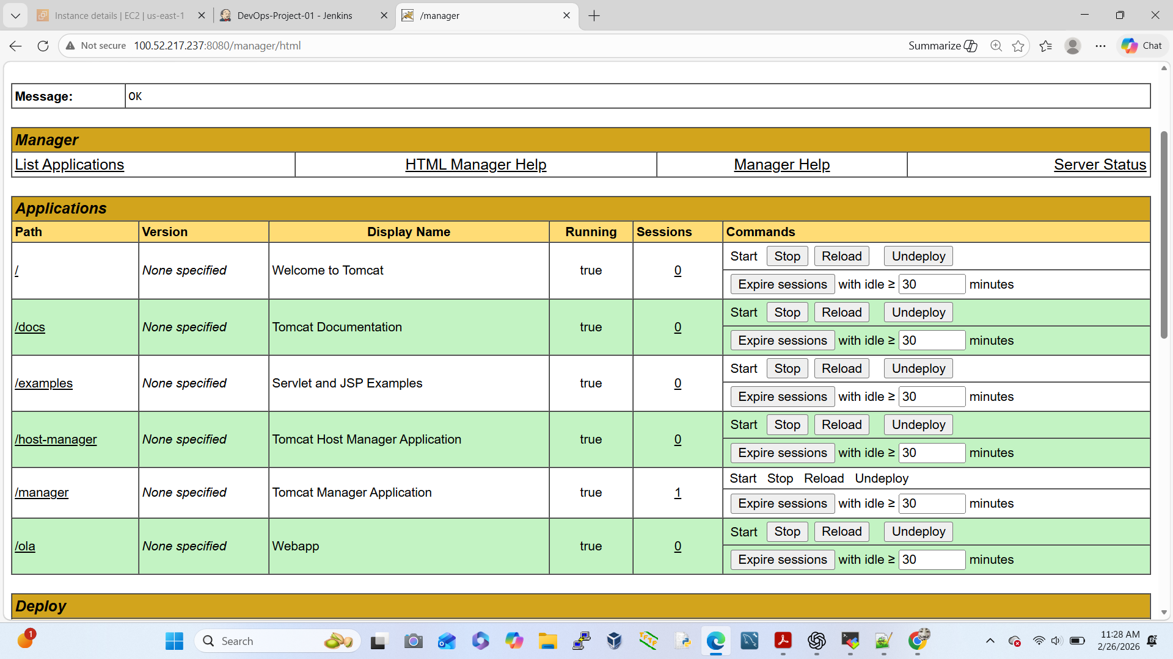
Configure Deployment in Jenkins
Go to Post-build Actions
Deploy WAR/EAR to a container
Configure:
WAR file: target/*.war
Container: Tomcat 9.x
URL: http://public ip:8080
Credentials: Azad/ Azad#1998
Save → Build Now

Slide 10
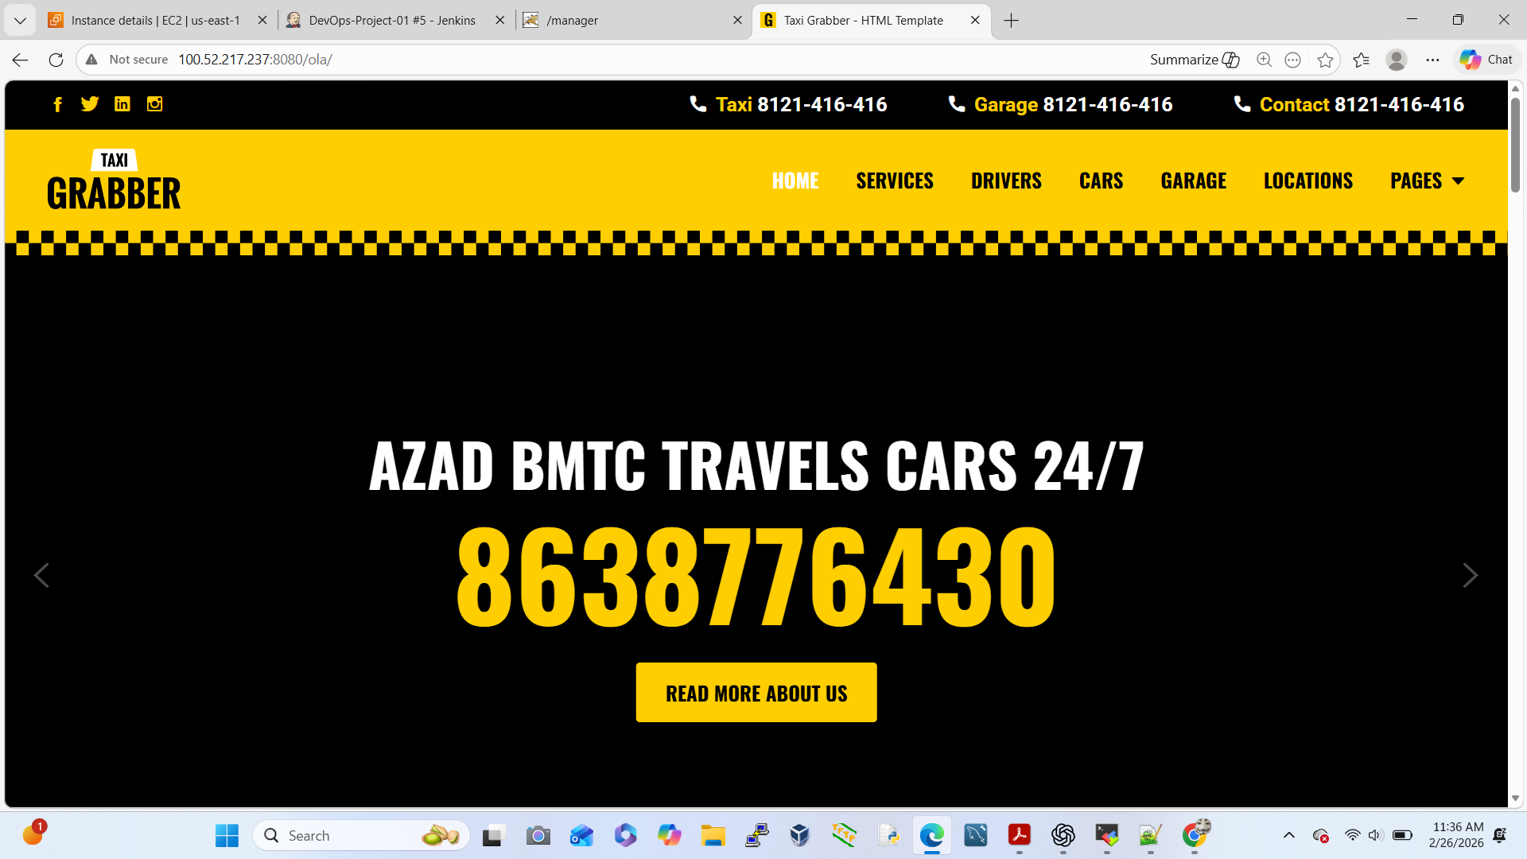
Verify Application in Browser
Go to the Chrome Browser
Open new Chrome Browser
http://localhost:8080/ola

